Slide 1
Day 3/100 Java Practice
100 Days of Coding Practice
Navaneethan

Slide 2
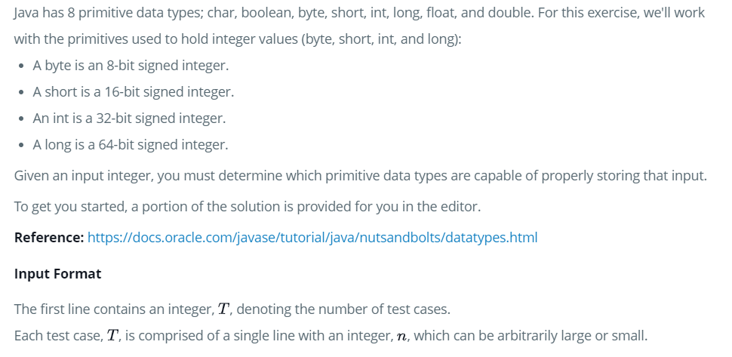
Prg – 1: Java datatypes

Slide 3
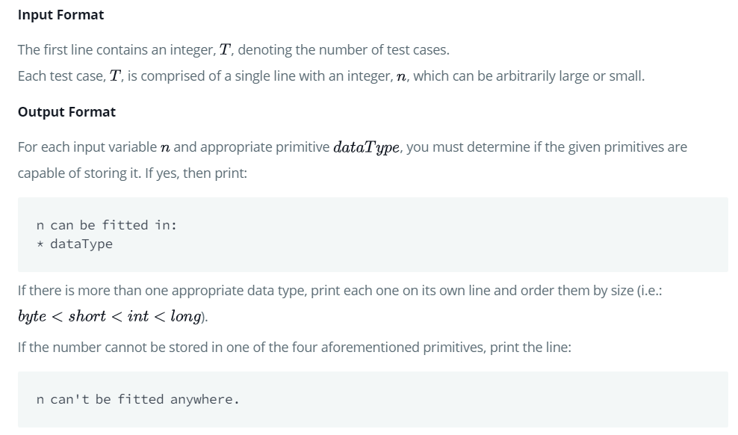
Prg – 1: Java datatypes

Slide 4
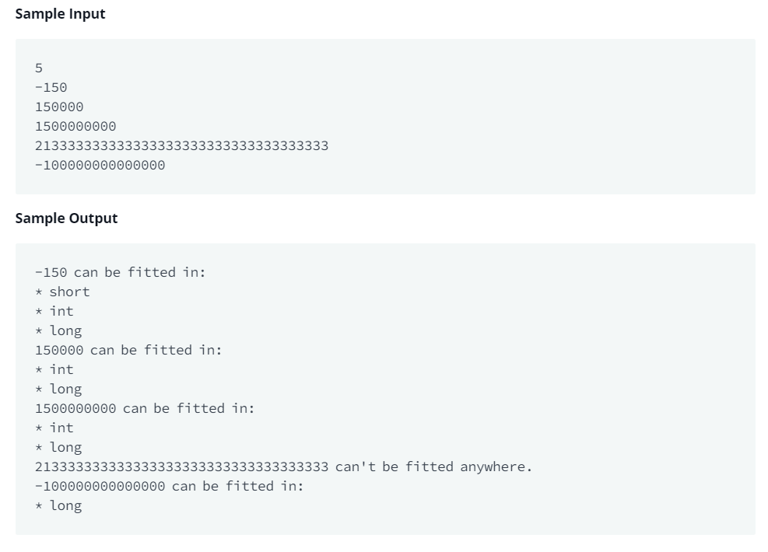
Prg – 1: Java datatypes

Slide 5
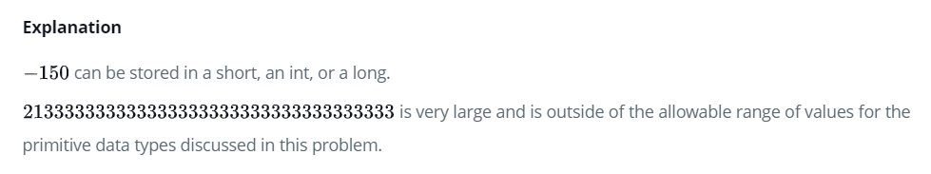
Prg – 1: Java datatypes

Slide 6
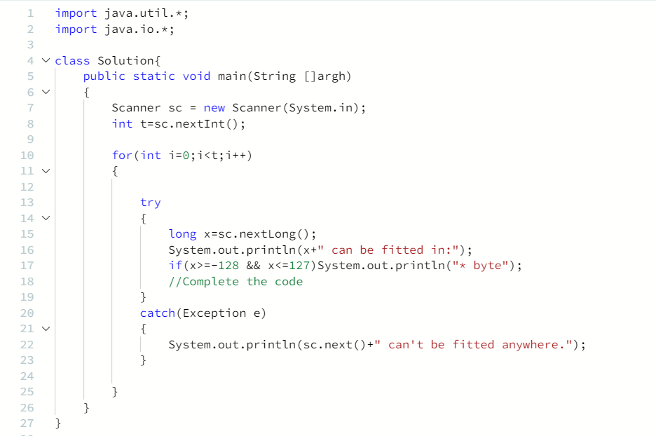
Prg – 1: Code snippet

Slide 7
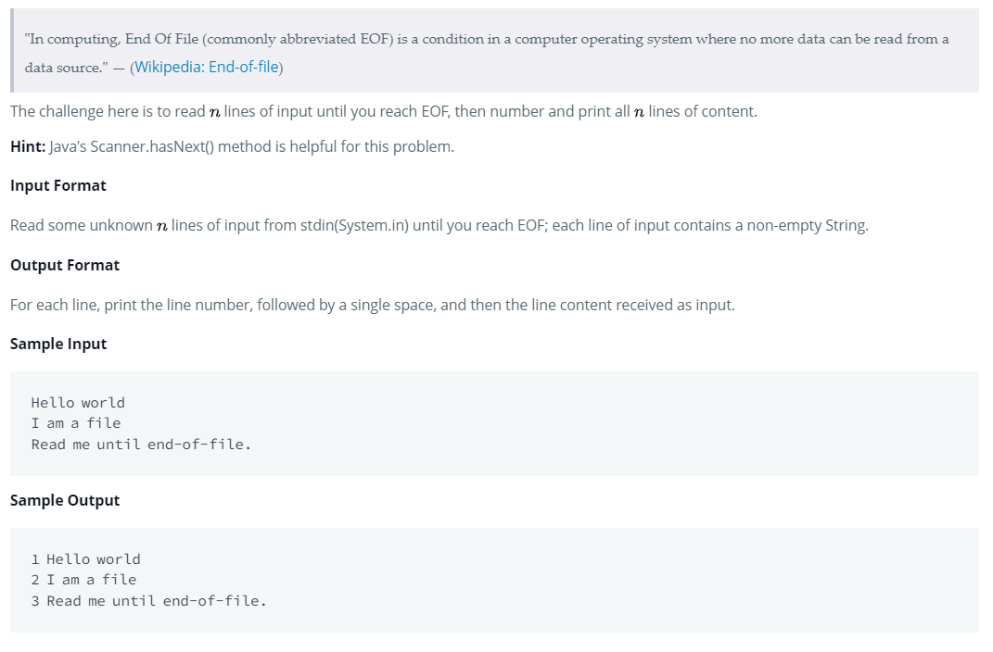
PRg – 2: Java end-of-file

Slide 8
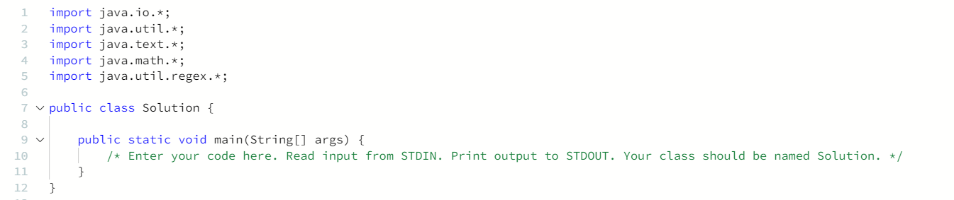
PRg – 2: Java end-of-file

Slide 9
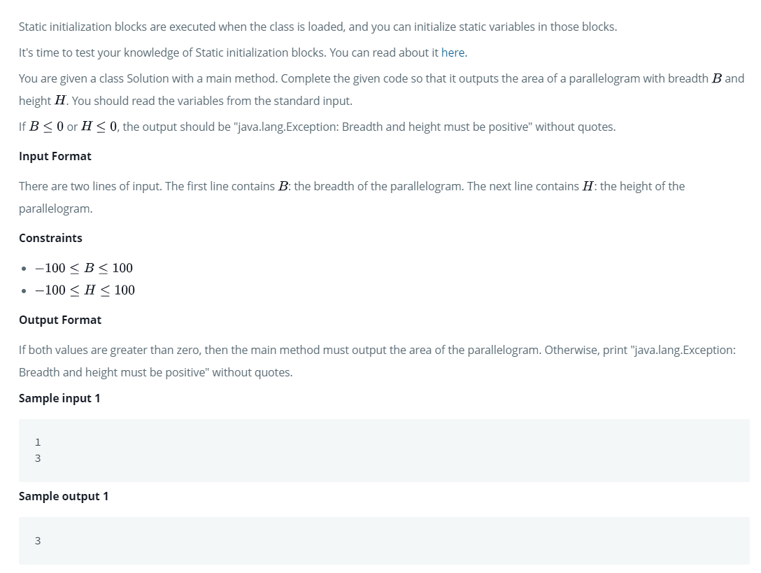
PRg – 3: Java static initializer block

Slide 10
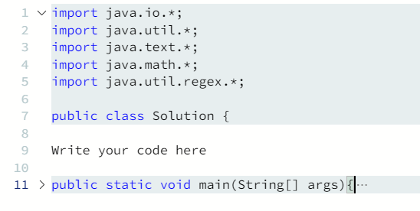
PRg – 3: Java static initializer block

Slide 11
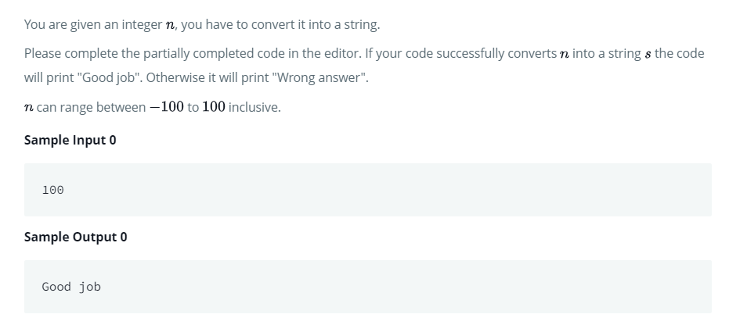
PRg – 4: java - Int to STRINg

Slide 12
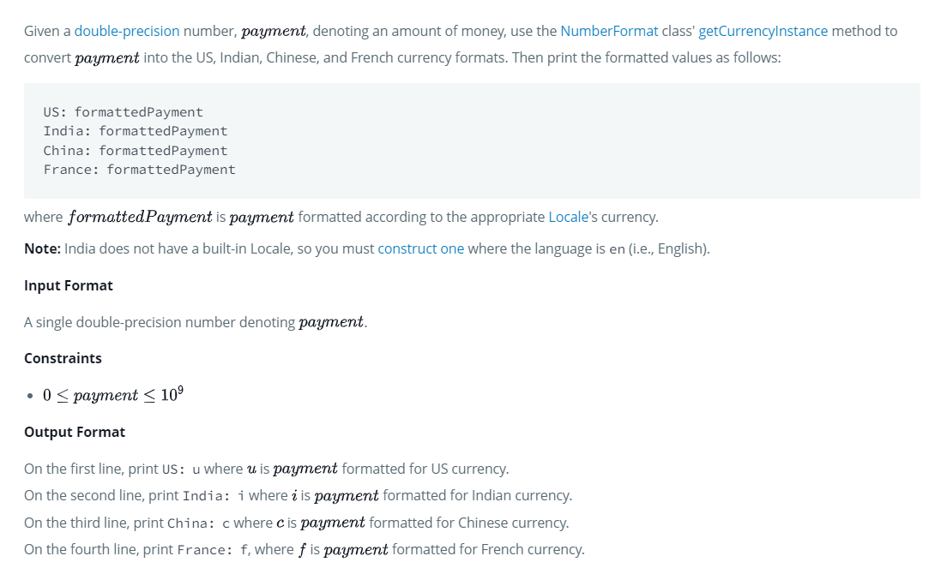
PRg – 5: java Currency formatter

Slide 13
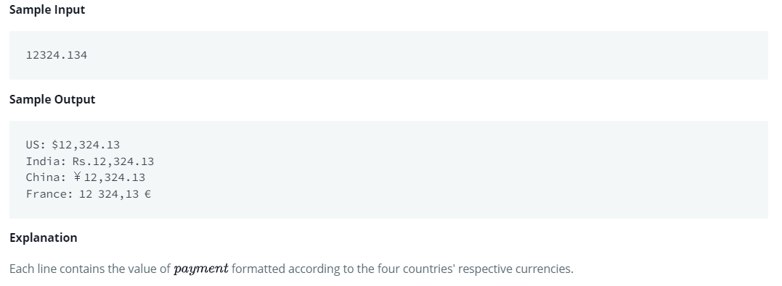
PRg – 5: java currency formatter

Slide 14
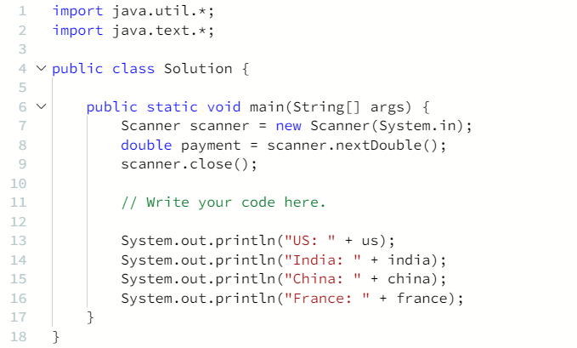
PRg – 5: CODE SNIPPET

